Slide 1
Arabic 2 Kurzban Welcome to Arabic 2 by Kurzban
Lesson 10: Seasons of the year.
Warm up: Connecting letters.
Seasons of the year Day 2
Practice
Homework:

Slide 2
Lesson 10:
Warm up: Connect the following letters:
ق+ب+ي+ح=
ج+م+ي+ل=
ط+و+ي+ل=
ق+ص+ي+ر=

Slide 3
Do Now: Review
Read and Translate the following:
سورية ___________ __________سوريّ
فَرَنْسا _______ ___________ فَرَنسيّ
_________________________________لُبْنان
انا مِصْريّ______________________________
هُوِ مِنْ مَدِينَة الْقَاهِرَة_____________________

Slide 4
Lesson 10:
List the days of the week starting with Sunday

Slide 5
Lesson 10:
Translate the following use your notes if needed:
Day:
Week:
Daylight:
Night:

Slide 6
What are the seasons of the year in Arabic: refer to notes from last class

Slide 8
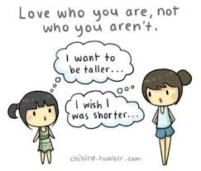
Describe what you see!
Beautiful
Ugly

Slide 9
Homework: List the days of the week, the seasons of the year and the numbers from 1-10. Must be typed in Arabic, organized and neat. No Excuses!!!

